Slide 1
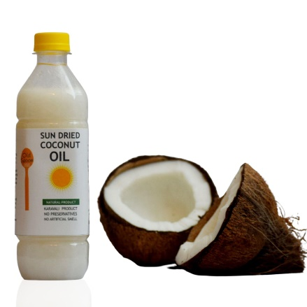
Project On Entrepreneurship
DEVELOPMENT OF COCONUT OIL MANUFACTURING plant
GUIDED BY:-
DR. APURBA GIRI
(Assistant professor and head)
AYAN MONDAL
(assistant professor)
PROJECTED BY:-
ABHISHEK PATRA
B.VOC(Food processing,6th sem)
Dept.of Nutrition
Mugberia Gangadhar Mahavidyalaya
Dept.of Nutrition
Mugberia Gangadhar Mahavidyalaya

Slide 3
CONTENTS
01
Introduction
02
Highly raw material production area
03
Machine
04
Manufacturing process
05
Investment
06
License
07
Marketing
08
Plant layout

Slide 4
Introduction
How to Get Started for a Manufacturing Business? The demand for coconut oil has skyrocketed in recent years due to the increasing knowledge of its numerous health benefits. It is a trendy superfood used in cooking and for its medicinal benefits. It is popular among the old as traditionally, it has been used in almost all Indian homes, especially in southern India. It is now gaining popularity among the young, for it is a favourite ingredient in several popular diets. Coconut oil has a rich flavour and mild aroma and has become popular with the growing demand for plant-based foods. It has several uses. Coconut oil manufacturing is a profitable business opportunity for new entrepreneurs.
Why is Coconut Oil Important? Coconut oil contains iron and vitamin K, which aid blood clotting, making it an excellent source of vitamins and minerals. It is also high in vitamin E, a powerful antioxidant that protects cells from damage. Coconut oil improves heart health by increasing HDL (high-density lipoprotein) cholesterol levels and improving the body’s ability to burn belly fat. It is an excellent skin and hair moisturiser.

Slide 5
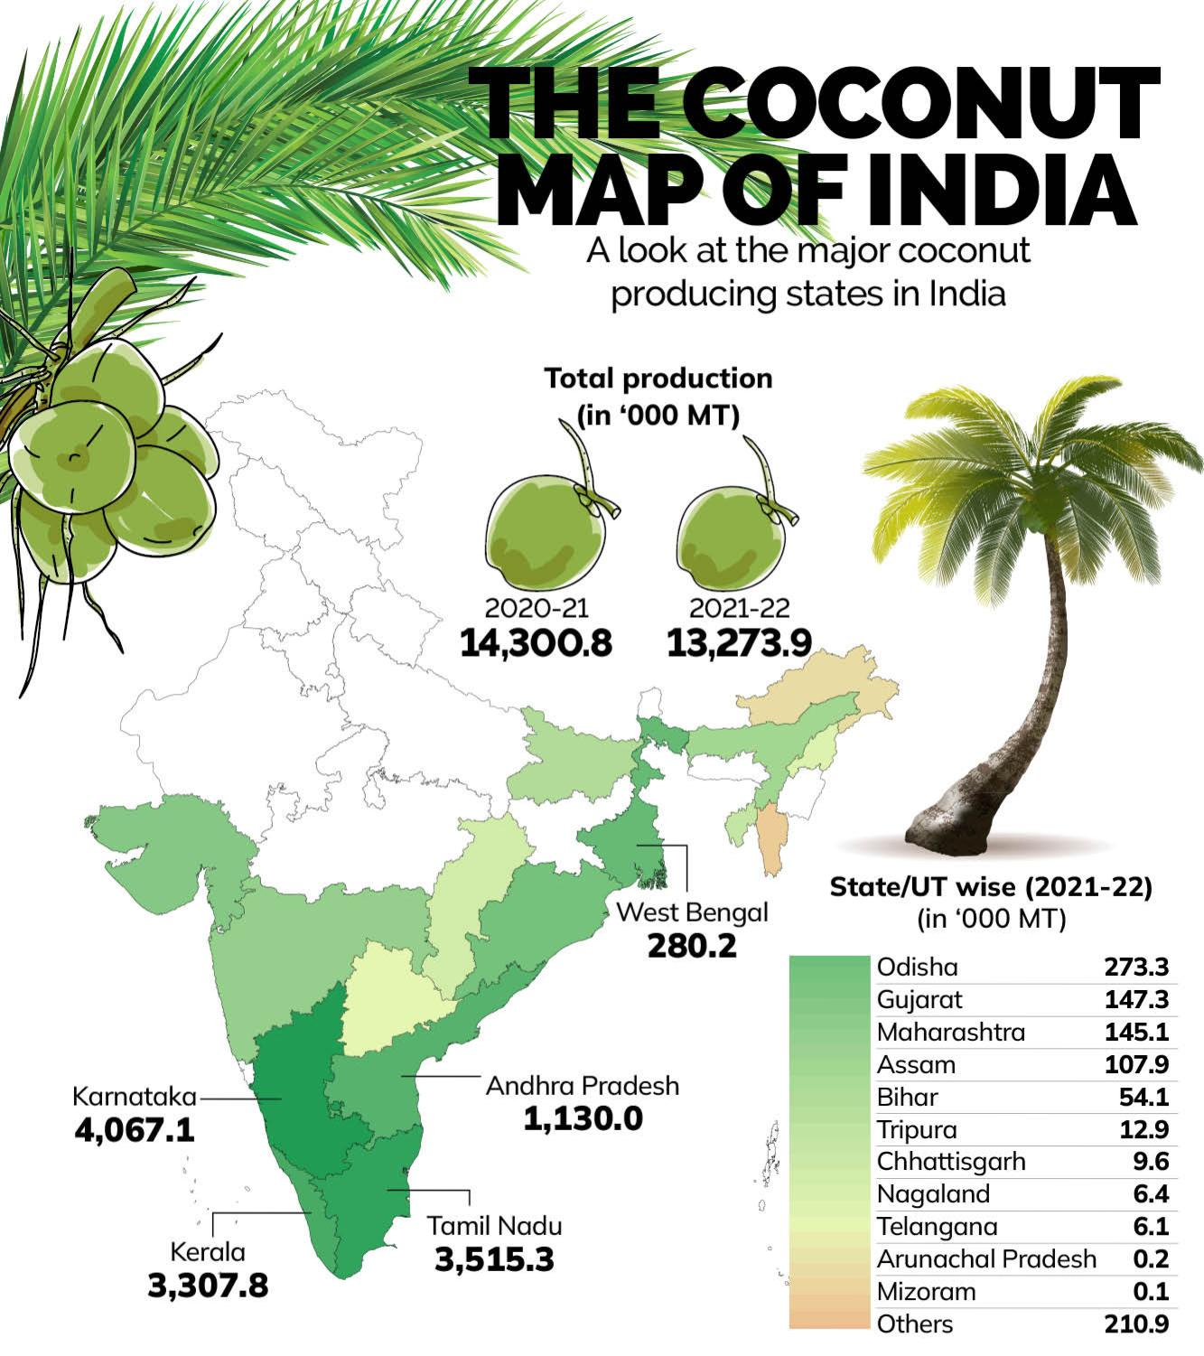
Highly raw material production area
Coconut is largely grown in the southern part of the Indian peninsula.
In the coastal areas, there are huge plantations, and hence this would be an ideal location to set up a business for the sheer availability of raw materials.
Coconut oil is used extensively, especially for cooking in India and other Southeast Asian countries.
As a result, we can say that coconut oil manufacturing is a profitable business opportunity for new entrepreneurs.

Slide 6
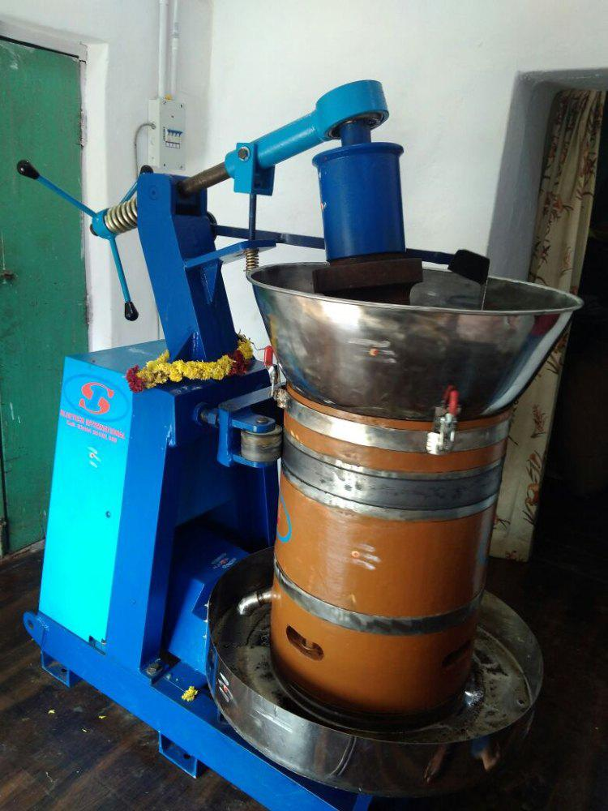
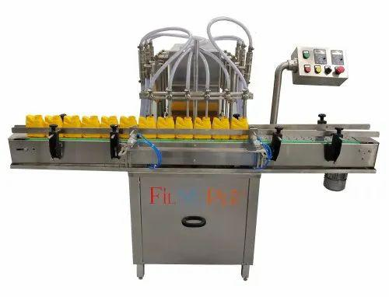
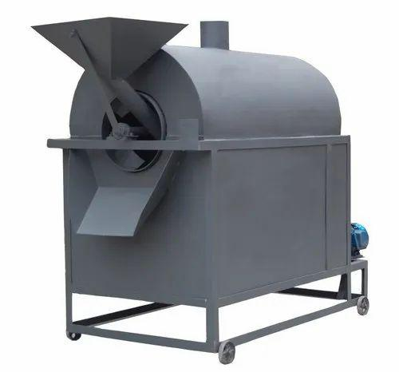
Machines needed for coconut oil manufacturing
Copra cutter
Roaster machine
Oil expeller
Coconut oil storage tank
Micro filter
Filtered oil storage tank
Volume matric filling machine
Wooden storage drums

Slide 7
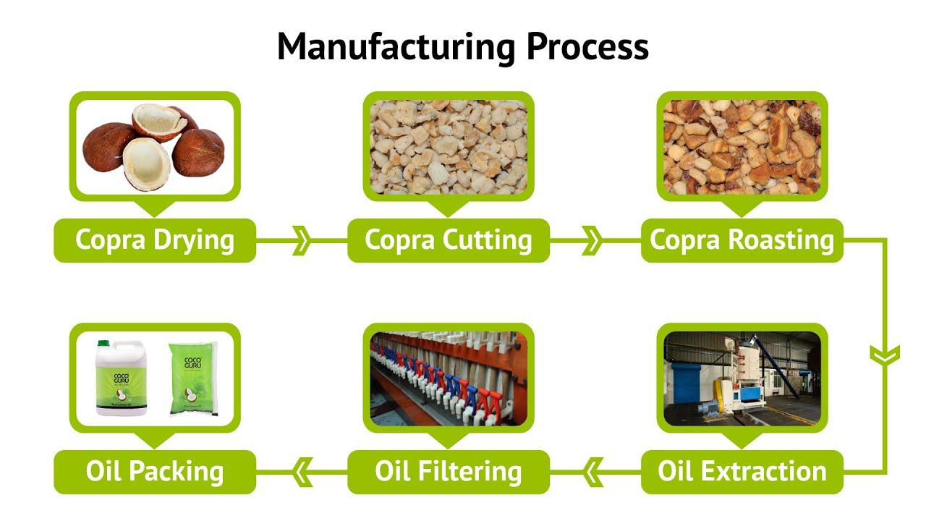
Oil manufacturing process

Slide 8
Oil cake
Coconut Cake Fertilizer is 100% Natural & organic, which when added to soil enriches it with vital nutrients, such as nitrogen, phosphorus, and potassium.
It prevents buds from falling off prematurely. Thus, highly beneficial for flowering, vegetable and fruit plants.
This oil cake can be used for further oil recovery with a solvent extraction process.
Oil cake can also be directly used as cattle feed. Oil cake is packed in plastic bags of 50 kg. It is attractive for cattle because of the roasted coconut smell

Slide 9
Investment
Investment in instrument:-Rs.80,000 to Rs.3,00,000
Building:-Rs.2,00,000
Land:-Rs.3,00,000
Raw material:-Rs.3,00,000
Electricity bill:-Rs.40,000/year
Manpower :-(10×10,000)+(2×15,000)+(3×15,000)+(1×20,000)+(1×30,000). =225,000/month
Profit
Production:- 1000L/day
Production cost for 1L:-Rs. 90 Distributor:-Rs.150
Market price:-Rs.190

Slide 10
LICENSE
REGISTRATION OF BUSINESS LICENSE
NOC FROM STATE POLLUTION CONTROL BOARD
FOOD SAFETY AND STANDARD AUTHORITY OF INDIA
TRADE LICENSE
REGISTER FOR TRADEMARK

Slide 11
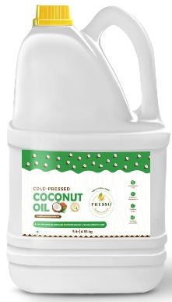
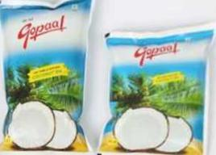
Marketing strategy
Selling strategy
Coconut oil in local market
Register in B2B and B2C website
Also sale supermarket small stores in shopping mall
Advertise
Advertise about my product through social media to get a huge number of clients in this way I can increase and promote my business
Through newspaper
5L:-Rs.940
1L:-Rs.190
500ml:-100

Slide 12
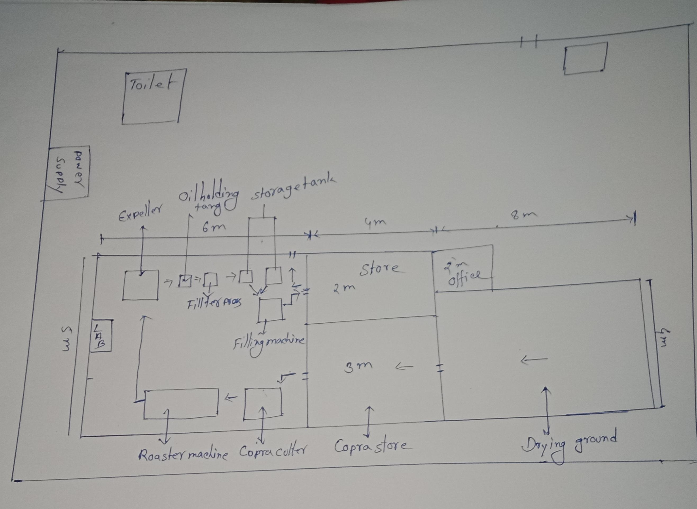
Plant layout

Slide 13
THANK YOU

